Slide 1

COVID-19
Prevention, treatment, and sequelae treatment
Please read the notes on each page for detailed information (It was originally used as a narration. In order to upload to GitHub, I deleted the narration to reduce the file size.)
Notes:
Hi, everyone!
Today is September 6, 2020. As of today, the cumulative number of people infected with COVID-19 in the world has reached 26 million, and the number of deaths from COVID-19 has reached nearly 900,000.
And so far, the epidemic has not been controlled. Most countries are still struggling with the epidemic.
In view of this, I made this video to help you.
In this video, I will introduce several prescriptions to prevent and treat COVID-19.
If you think my spoken English is not pleasant enough, please forgive me. I haven't spoken English since I graduated 20 years ago. I never thought that one day I would need to say something in English. However, the COVID-19 broke out.
Hope this video can help you.

Slide 2
Let’s start from myth…
Notes:
Because the prescriptions I want to introduce are so magical, I must start from myths.

Slide 3
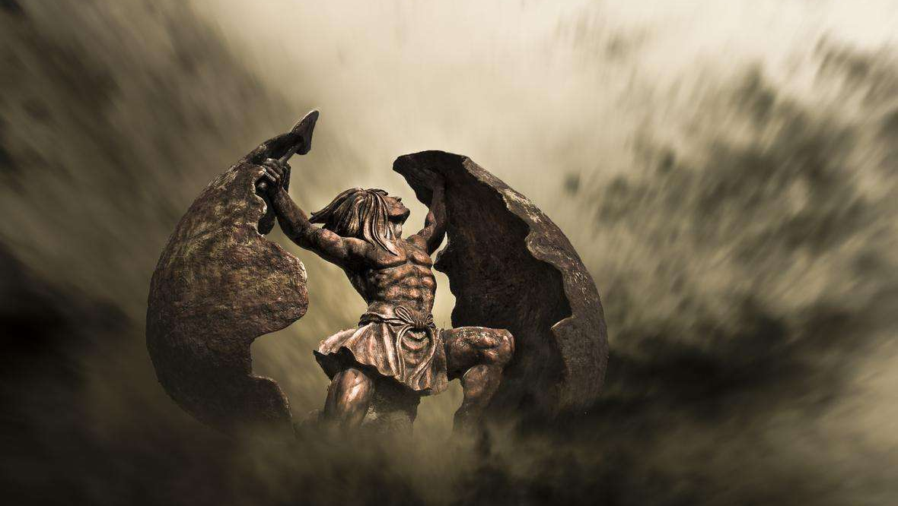
In Chinese mythology, the world was created by a god named Pangu(盤古).
Notes:
In Chinese mythology, the world was created by a god named 盤古.When he finished, there were flowers, trees, birds, beasts, fish and insects on the ground.

Slide 4
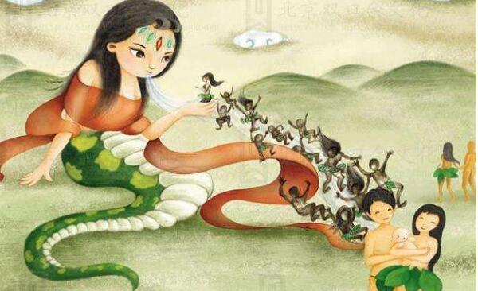
Goddess Nuwa(女媧) made people from clay
Notes:
And, 女媧 is the goddess who created mankind
女媧 had a human face and a snake body.
女媧 thought that 盤古’s creation was not complete.
So she used clay to pinch the figurines, and blew a breath at them
Then the little clay figurines were infused with vitality and came to life.

Slide 5
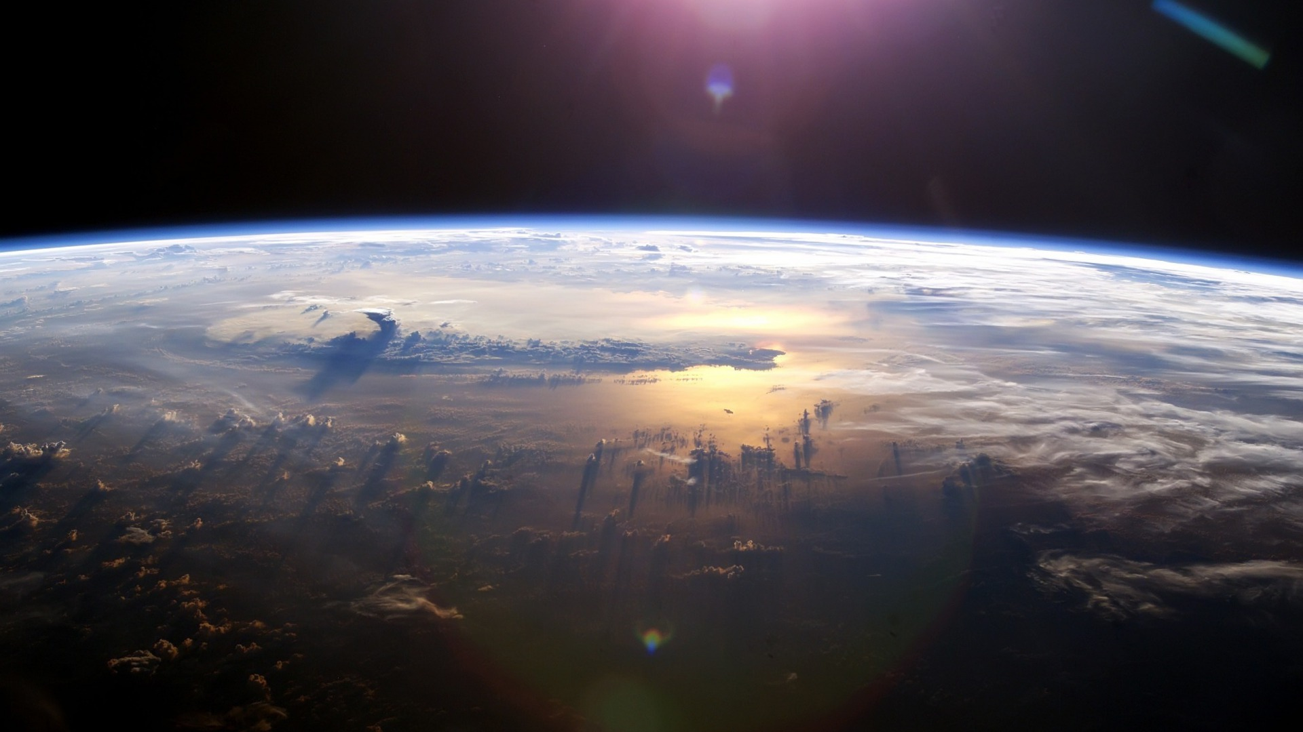
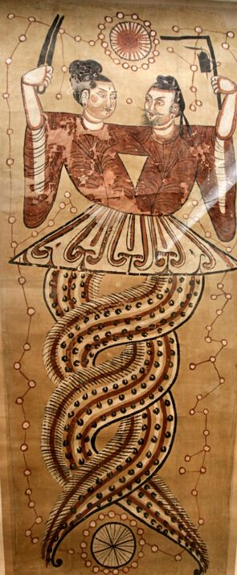
Nuwa had a husband named Fuxi(伏羲)
Fuxi is also human face and snake body
Nuwa’s right hand holds a compass, and Fuxi’s left hand holds a square.
Their tails are entwined.
Some researchers suspect that this hints they were actually scientists. Their entwined tails actually hint at the double helix structure of DNA.
⬅ Unearthed cultural relics: Picture of Fuxi and Nuwa
Nuwa and her husband Fuxi
Notes:
女媧 had a husband named 伏羲
The picture on the left is an unearthed relics: picture of Fuxi and Nuwa.
We can see that 伏羲 is also human face and snake body
女媧’s right hand holds a compass, and 伏羲’s left hand holds a square.
And Their tails are entwined.
Because compass and square are mathematical tools,
Some modern researchers suspect that this hints they were actually scientists.
Their entwined tails actually imply the double helix structure of DNA.

Slide 6
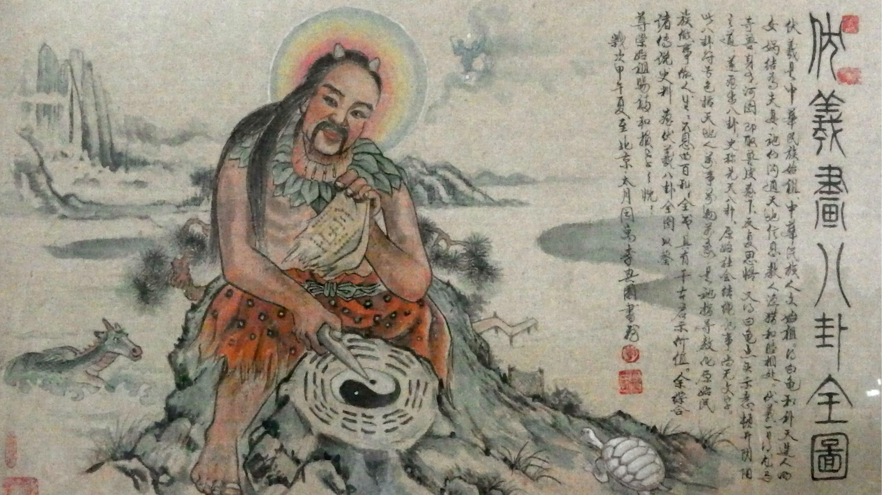

龍的傳人前來拜見始祖……
伏羲不是蛇尾嗎？怎麼長了兩條腿？
這是後人根據傳說畫的……不要在意這些細節
Fuxi observed astronomy and geography and invented “I Ching(易經)”
Notes:
In Chinese mythology, Fuxi created 易經八卦 by observing astronomy and geography.
"易" means "change" and "经" means "classic book". Therefore, "易经" is also translated to "Book of Changes" in English.
As for “八卦”, it is the symbol system used in “易經".
This painting describes how he did it.
You may have noticed that Fuxi has two legs in this painting. That is because this painting is drawn by later generations according to myth, so please don't care about these details.
The god 伏羲 taught 易經 to people. In other words, Chinese god proactively gave the fruits of wisdom to people at the very beginning.
The myth is too long to be verified, but "易经" has indeed been passed down by the Chinese. Today, anyone can easily buy books about "易经" from bookstores.

Slide 7
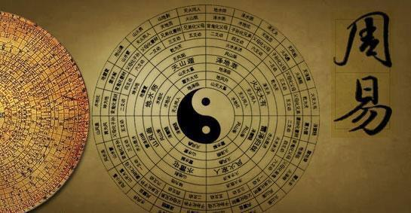
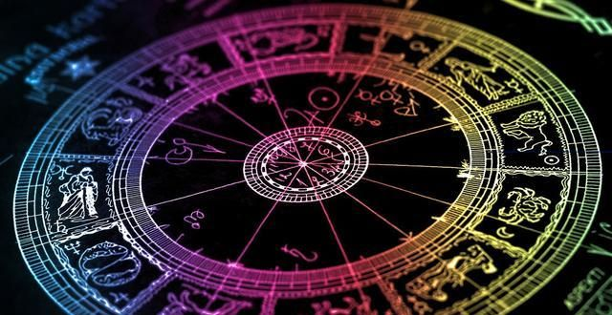
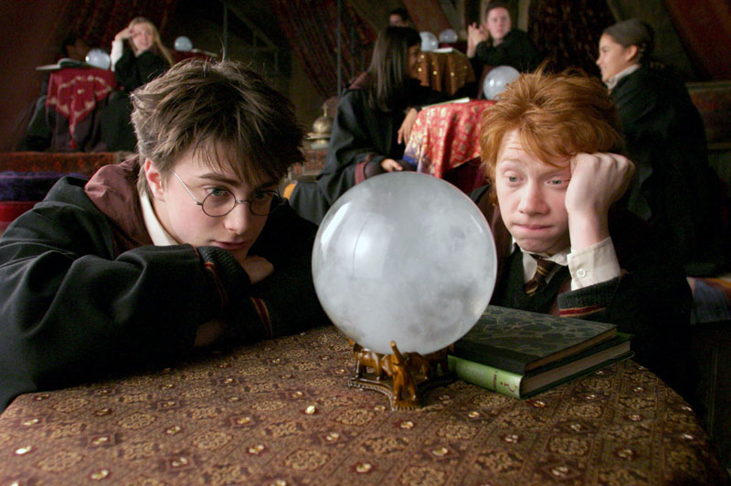
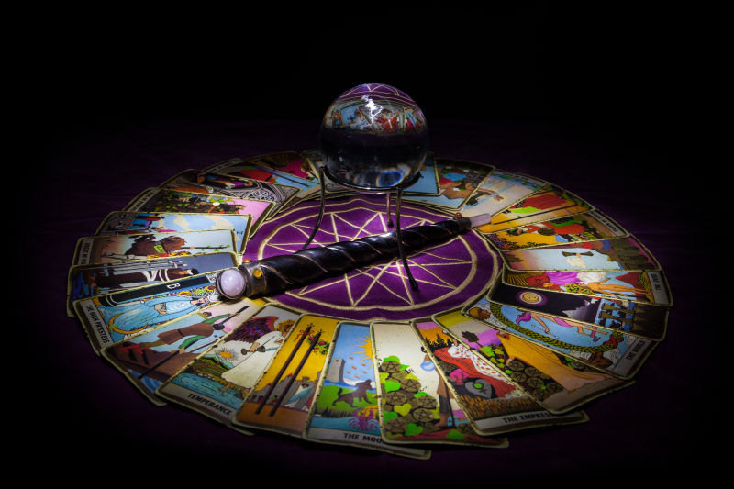
“I Ching” is usually used for divination, just like astrology, crystal ball, and tarot cards
Notes:
In China, “易經” is usually used for divination, just like astrology, crystal ball, and tarot cards
These divination techniques are in similar situations in countries around the world: some people believe in it deeply, some people are dubious, and some don't believe it at all.

Slide 8
But what “I Ching” can do is far more than divination
“I Ching” can be used in any majors
Notes:
But in fact, it doesn‘t matter whether you believe 易經 or not.
Because 易經 can do much more than divination.
易經 is a great theory. Unlike the highly specialized modern civilization, the theory of 易經 is applicable to all majors. And, the results are easy to verify.
I will prove it to you right away

Slide 9
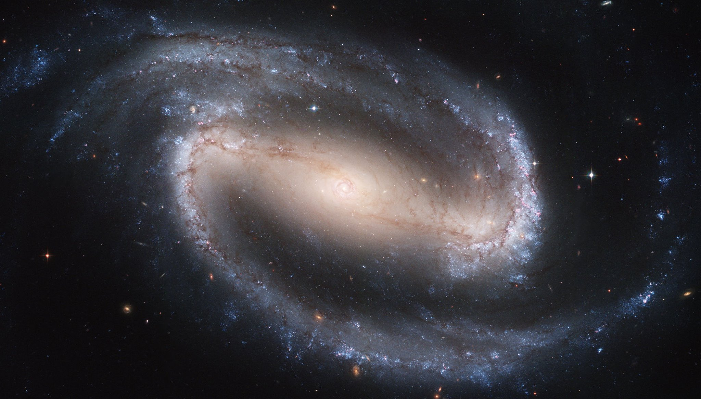
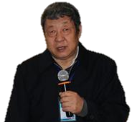
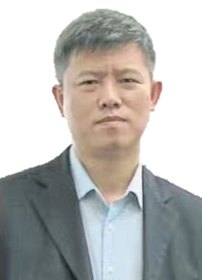
Professor Zhang Yansheng (張延生)
Graduated from the Department of Engine Technology, Beijing Institute of Aeronautics and Technology, majoring in technology in 1969
Served as an engineer in the Technical Office of the Machinery Plant of Beijing University of Aeronautics and Astronautics
Director of “I Ching” teaching and Research Office of Guangming TCM Correspondence University.
Part-time
Vice President of China “I Ching” Research Association,
Honorary President of China “I Ching” Culture Conference
Director of Chinese Celebrity Association
Chairman of Yanhuang Taoist Culture Research Association
Director of Chinese Medical Qigong Research Association
(Appointed in April 1988) Consultant of the Hand Clinic Research Association of Beijing College of Traditional Chinese Medicine
And was hired by dozens of companies, institutions, units, etc. as decision-making or guidance consultants
Founder of Zhang’s Theory
Doctor Long Weiquan（龍衛權）
In 1982, graduated from Hainan University School of Medicine
In 1986, studied “I Ching” under the tutelage of Pro. Zhang Yansheng, closely integrated the medical theory of Chinese medicine with the “I Ching”, and proposed a new medical method
In 1987, abandoning Western medicine, modernizing Chinese medicine
In 1991, the world's first drug-cured blood cancer patient (cured with traditional Chinese medicine, no bone marrow transplantation, survived until now)!
In 1997, used “I Ching” theory to the financial market on Wall Street and got a return of 3175.9% in 3 months, which proved “I Ching” can guide the financial market (with detailed transaction history of the account opening brokerage firm)
In 2003, the world’s first online Chinese medicine hospital, online ς diet was completed, a milestone in Chinese medicine, patients can download Chinese medicine prescriptions directly from the Internet
Notes:
Here please allow me to introduce you two masters of 易經
The one on the left is called “張延生". He has a long resume, so I won't read it one by one. If you are interested, you can pause the video and read it carefully.
In short, Pro. 張延生 founded the “Zhang‘s Theory”, one of the most famous inheritances of 易經
The one on the right is called “龍衛權”, he is a disciple of Pro. 張延生.
Dr. 龍衛權 originally graduated from Western Medical College. After he studied the 易經 with Pro. 張延生, he gave up Western medicine and became a Chinese medicine physician
In 1991, he cured a blood cancer patient with Chinese medicine, while the patient had been given up by western doctors before
In 1997, he tried to use 易经 theory to guide financial investment. In 3 months, the funds increased by 31 times.
In 2003, he founded the world's first online Chinese medicine hospital on the Internet

Slide 10

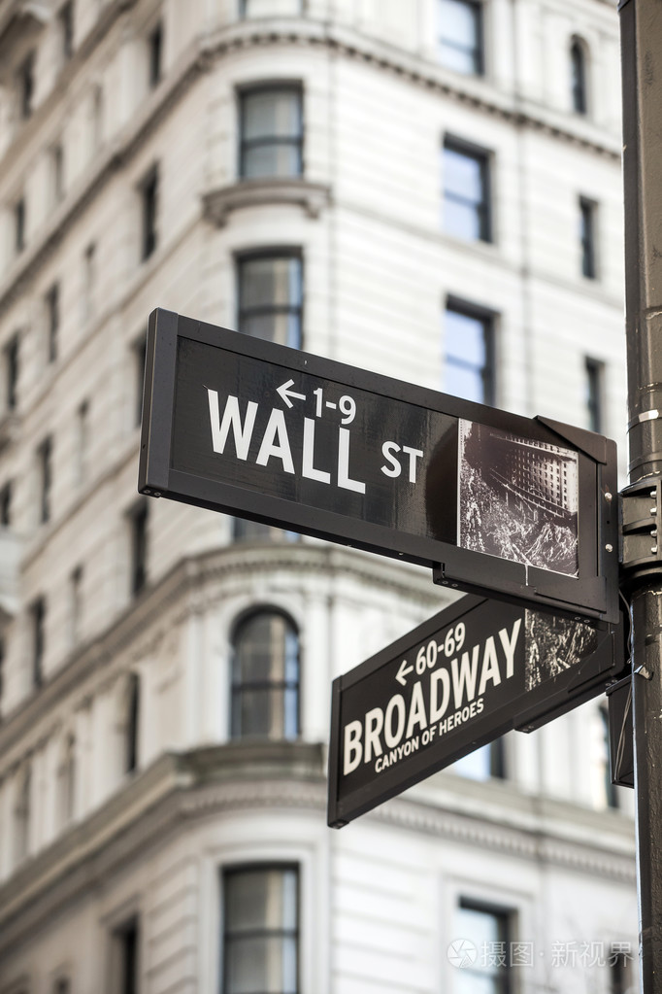
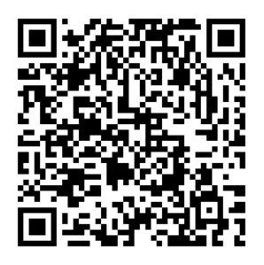
“From November 12, 1997 to February 12, 1998, in a practice of applying Zhang’s theory to foreign exchange futures, I entered the market for 38 days and made 66 transactions.
The result was 45 gains and 21 losses.
The funds I operated increased by a total of 3,175.9%.
The huge rate of return proves that ‘I Ching’ can guide financial markets.”
--Dr. Long Weiquan
Application of “I Ching” theory on Wall Street in 3 Months ── 3175.9% rewarded
Notes:
This page records the experiment in which Dr. 龍衛權 used the theory of 易經 to guide financial investment.
Let's see what he said:
“From November 12, 1997 to February 12, 1998, in a practice of applying Zhang’s theory to foreign exchange futures, I entered the market for 38 days and made 66 transactions.
The result was 45 gains and 21 losses.
The funds I operated increased by a total of 3175.9%.
The huge rate of return proves that 易經 can guide financial markets.”
Click on the link below the title, you can see the detailed introduction of this experiment. At the bottom, you can also find a link to the detailed transaction records of the account opening broker.

Slide 11

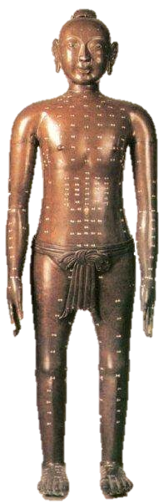
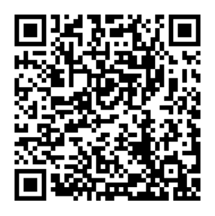
In 1991, a Chinese-Canadian boy named Gordon was diagnosed with family hemophagocytosis （https://www.duosuccess.com/tcm/017z030328.htm）
According to the common sense of western medicine, bone marrow transplantation is necessary to heal, otherwise he may die at any time
With the help of all walks of life, his family raised bone marrow donations from Chinese people around the world
Unfortunately, none of them matched
They returned to Toronto sadly
But, they were lucky enough to meet Dr. Long Weiquan.
After receiving the five-month treatment of Dr. Long, he finally recovered.
Strictly speaking, he recovered in two weeks, after which it was just conditioning.
This is a complete discontinuation of drugs, no need to see the doctor again, no sequelae, high quality survival, and a life like normal people.
Application of “I Ching” theory on medical - The world's first drug-cured blood cancer patient
Notes:
In this page, you can see how Dr. 龍衛權 applied 易经 theory on medical.
This is a case of a blood cancer patient cured by Chinese medicine
（开始念页面上的英文就好）

Slide 12
Prescriptions for COVID-19
Prevention, Treatment & Sequelae treatment
Notes:
After watching all the previous introductions, Do you have any confidence in Dr. Long?
If the answer is yes, then please follow me to the most critical part: Prescriptions for COVID-19
These prescriptions are located in the online hospital founded by Dr. 龍衛權
The name of the hospital is DuoSuccess.
Now Let’s turn to it.

Slide 13
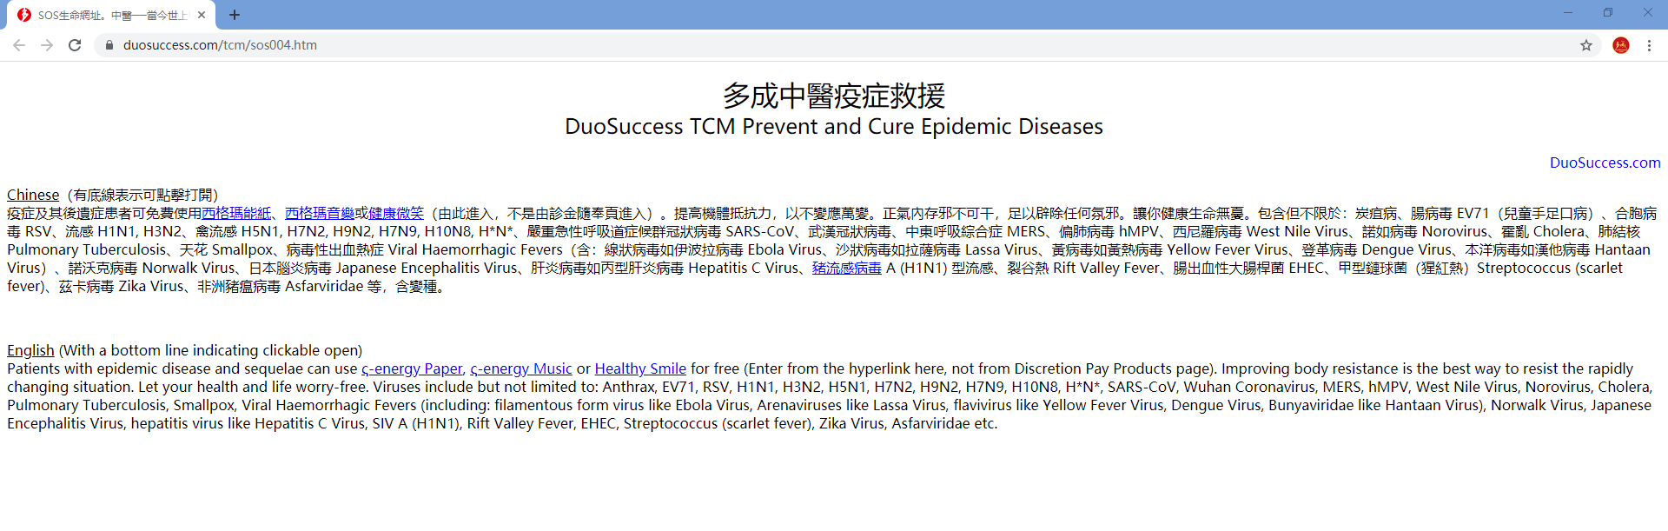
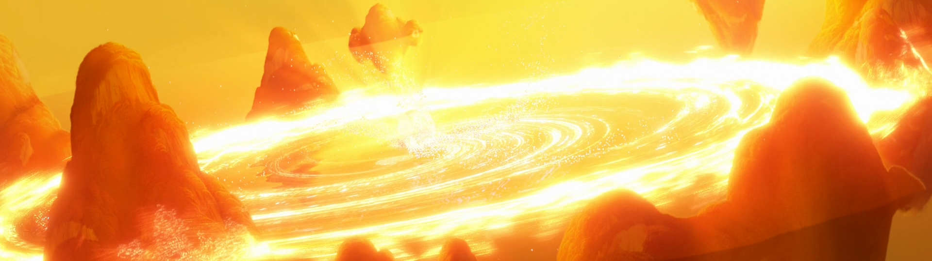
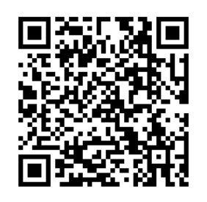
Click here to open sigma energy paper
Note: To obtain the effect of preventing & curing the epidemic, you must click on this page to enter these 3 prescription pages Opening the prescription page directly is INCORRECT.
DuoSuccess TCM Prevent and Cure Epidemic Diseases
Notes:
You can see that this is a web page.
You can open this page by inputting the URL displayed in the address bar into your browser, or scan the QR code in the lower left corner to open this page
DuoSuccess TCM can treat many diseases, but this page is DuoSuccess Epidemic Rescue Homepage, it is designed for infectious diseases specially.
This is the most important page. I suggest you add it to your favorites.
This webpage is in Chinese and English. And the content is exactly the same.
This webpage contains 3 prescriptions, each of them can treat COVID-19 separately, -- actually they can treat all infectious diseases including COVID-19
Note that you must click into these 3 prescriptions from this web page to get the effect of treating infectious diseases.
I’ll introduce these 3 prescriptions in turn.
Now, let’s click the link of Sigma energy Paper

Slide 14
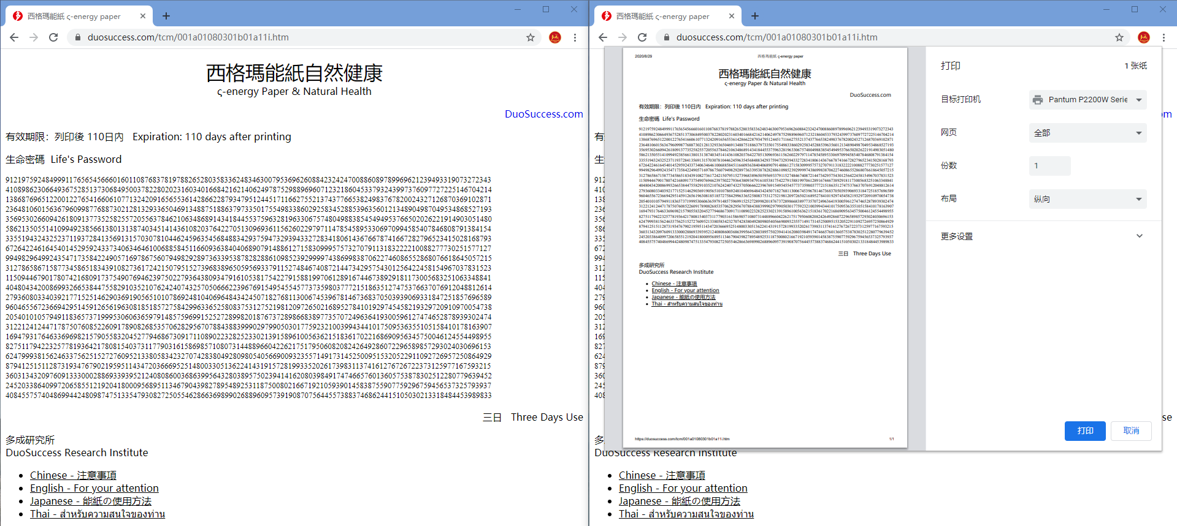
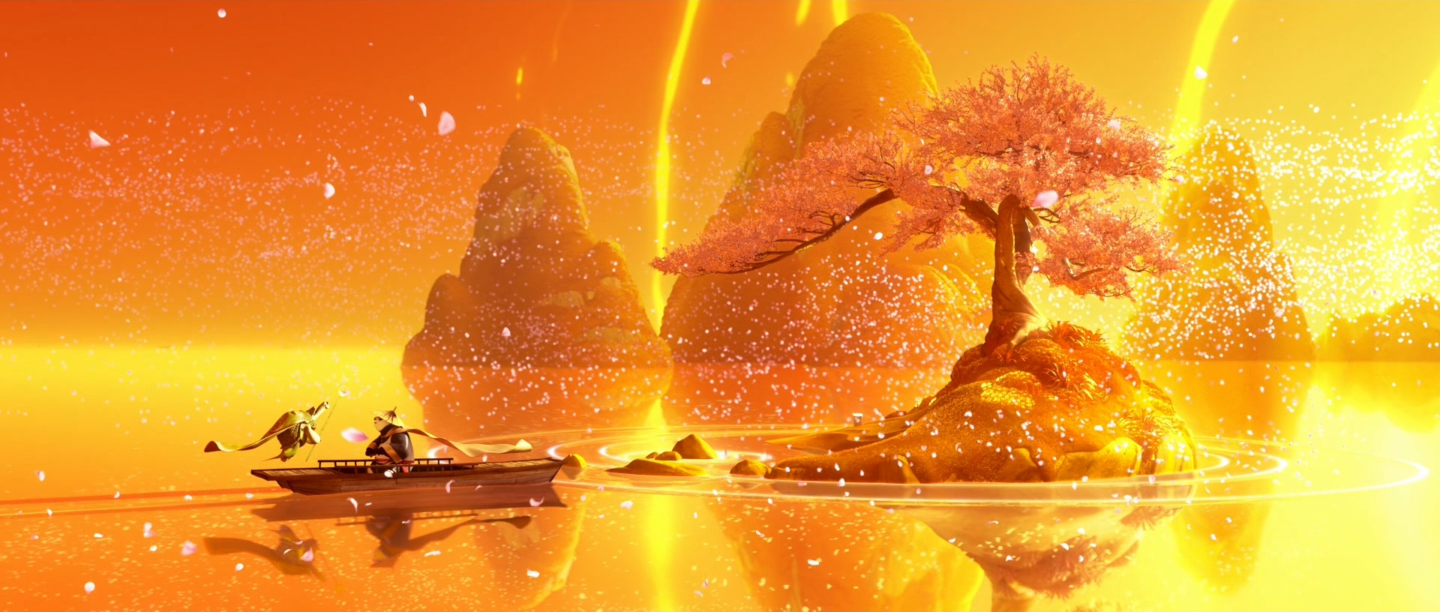
Click here to expand English description
DuoSuccess TCM Prevent and Cure Epidemic Diseases - ς-energy Paper & Natural Health
Notes:
OK, The new opened page looks like this.
There are English description at the bottom of this page, but folded by default. You can click to expand it.
Right-click on the page and select "Print" to print the page. You can print multiple copies at one time.
If you need to print again, you must refresh the page first to ensure that the page comes from the server instead of the local cache.
If you expanded the description before, I suggest you fold it before printing to prevent the content from exceeding one page.
Because you need to print, you need to open this web page on a computer that connects to printer. You cannot save the webpage locally and then take it to another computer to print. The prints printed in that way have no therapeutic effect.

Slide 15

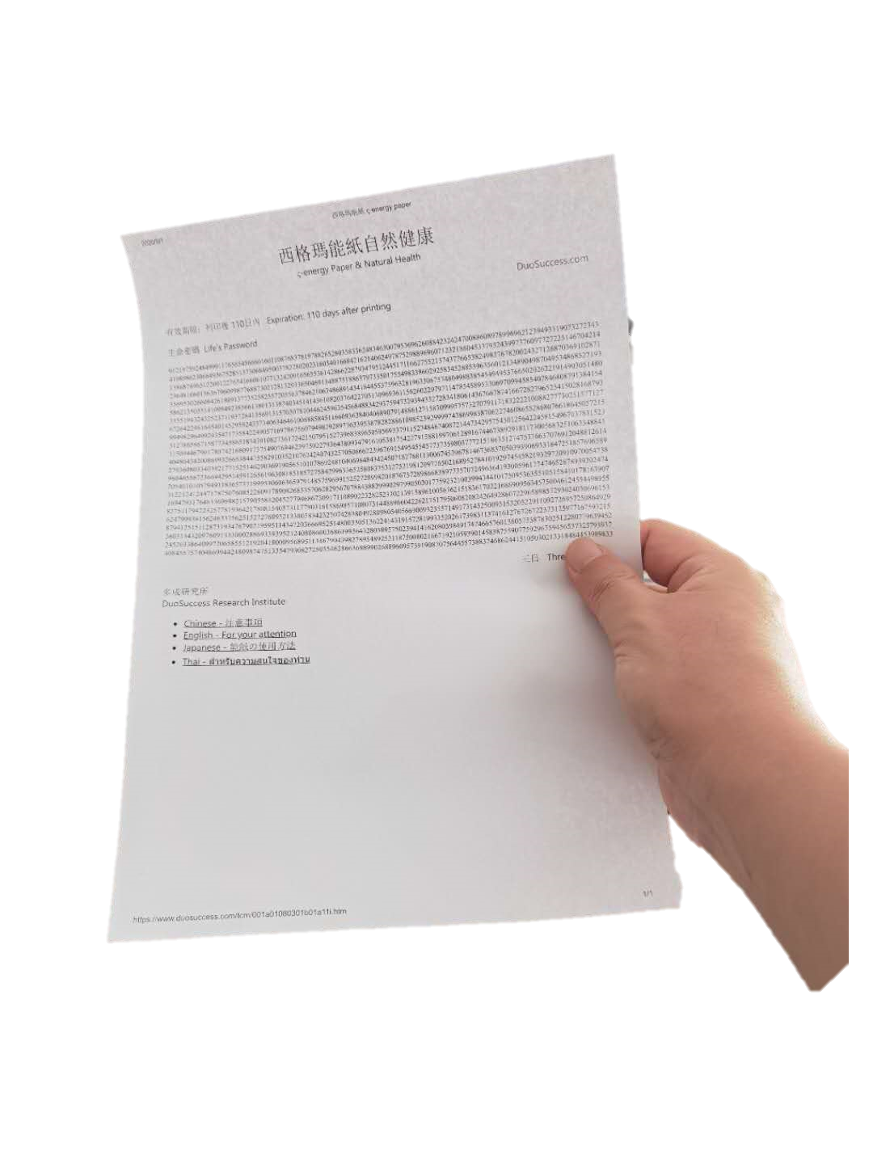
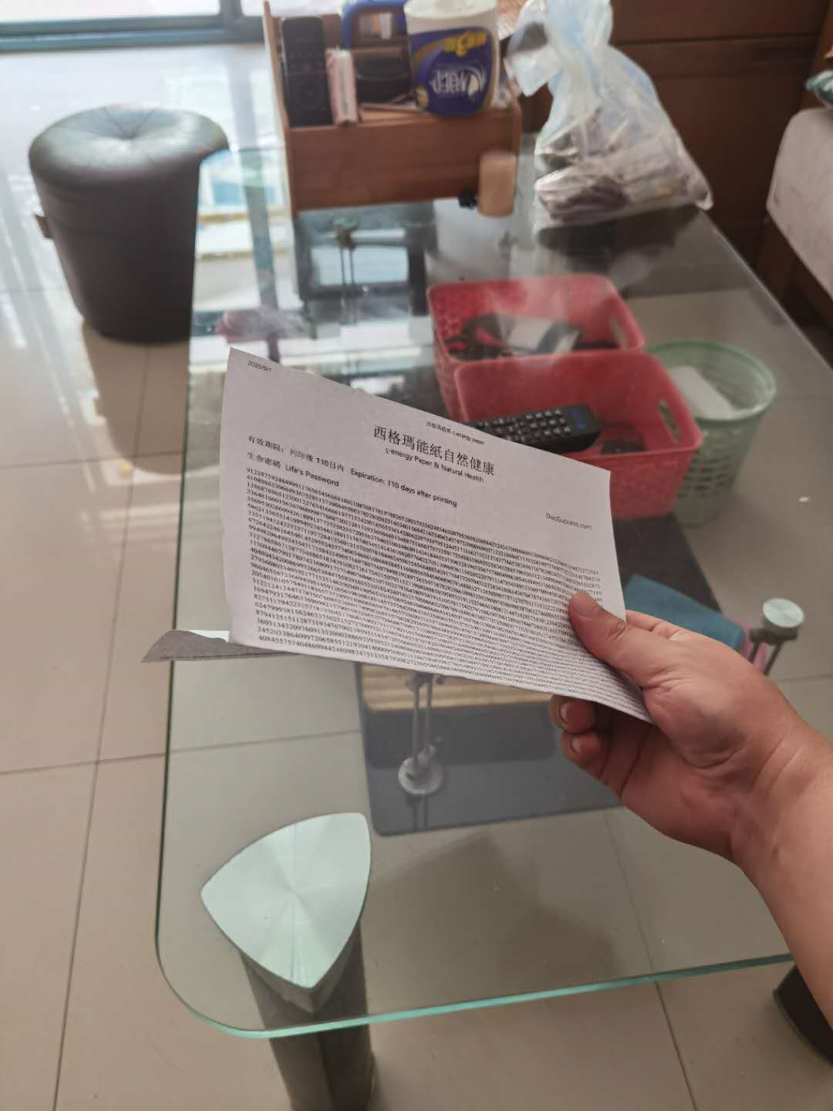
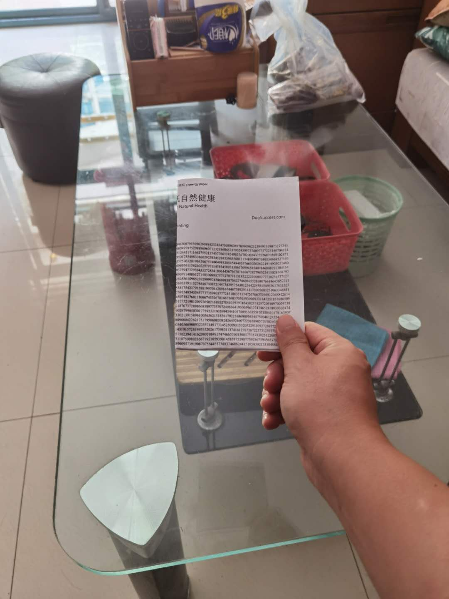
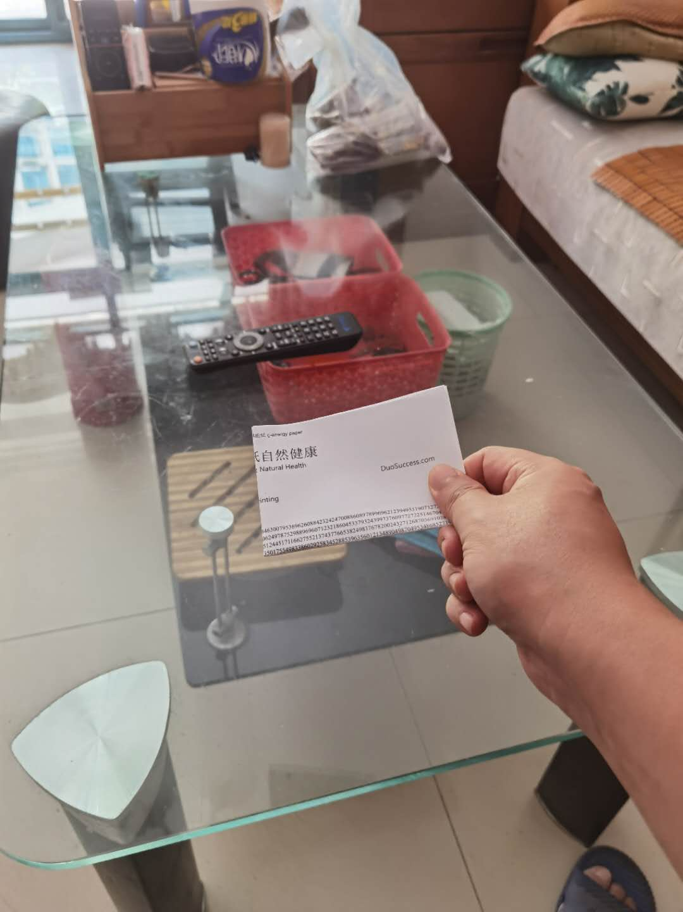
②
For those who can walk
After printing this page, we get an A4 print
Fold in half
Fold in half again
Repeat this action until the paper fits in your pocket
Put it into your pocket
For bedridden patients
put the paper directly under his pillow (the worded side up)
Usage:
Normally, each sheet of paper can be used for 3 days
But if this paper is discolored or broken, please replace it immediately
The replaced paper is recommended to be burned.
①
③
④
How to use the ς- energy paper
Notes:
Okay, now we have a printout. How to use it?
Fold the paper in half with the words outward several times until it fits in your pocket. Then put it in your pocket.
For bedridden patients, put the energy paper directly under the pillow. Attention: the side with words must face up.
Normally, each piece of energy paper can be used for 3 days, and then must be replaced with a new energy paper.
If the paper is discolored or broken, please replace it immediately.
It is best to burn the replaced energy paper. If there are no conditions, tear it up before throwing into the trash can.

Slide 16
Click here to open sigma energy music
Note: To obtain the effect of preventing & curing the epidemic, you must click on this page to enter these 3 prescription pages Opening the prescription page directly is INCORRECT.
DuoSuccess TCM Prevent and Cure Epidemic Diseases
Notes:
OK, After introducing the Sigma energy Paper, we return to DuoSuccess Epidemic Rescue Homepage.
This time we’ll click the link of Sigma energy music.

Slide 17
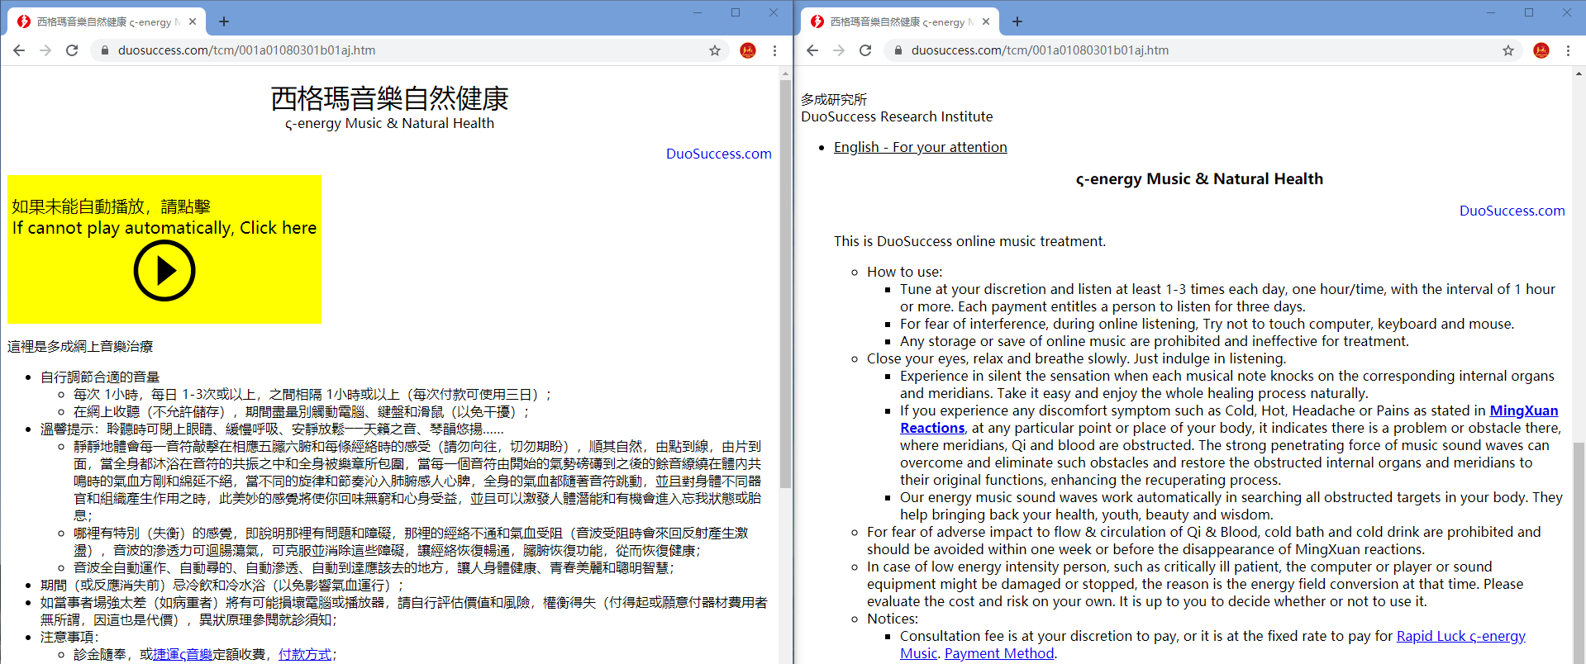
Click here to expand English description
DuoSuccess TCM Prevent and Cure Epidemic Diseases - ς-energy Music & Natural Health
Notes:
This is the sigma energy music page.
This page can play a music, which can be used to cure epidemic patients .
Actually there is a background music, but only can be played in Microsoft IE.
If your browser is not IE, you won’t hear it.
If so, you can click the play button on the webpage to start playing.
The music will last for 1 hour. The patients can listen 3 times a day, with at least one hour interval between each two.
Please do not listen to this music with headphones. It’s not just the ears that listen to music.
If you connect this music to a radio or TV system and let people receive and play this music, you can cover a large area in an instant and solve the epidemic in this area. This area can be as large as the entire country.
You must play this music online. You cannot save this music locally and then play it.

Slide 18
Click here to open Healthy Smile
Note: To obtain the effect of preventing & curing the epidemic, you must click on this page to enter these 3 prescription pages Opening the prescription page directly is INCORRECT.
DuoSuccess TCM Prevent and Cure Epidemic Diseases
Notes:
OK, we have finished introducing the Sigma energy music, now we return to DuoSuccess Epidemic Rescue Homepage again.
This time we’ll click the link of Healthy Smile.

Slide 19
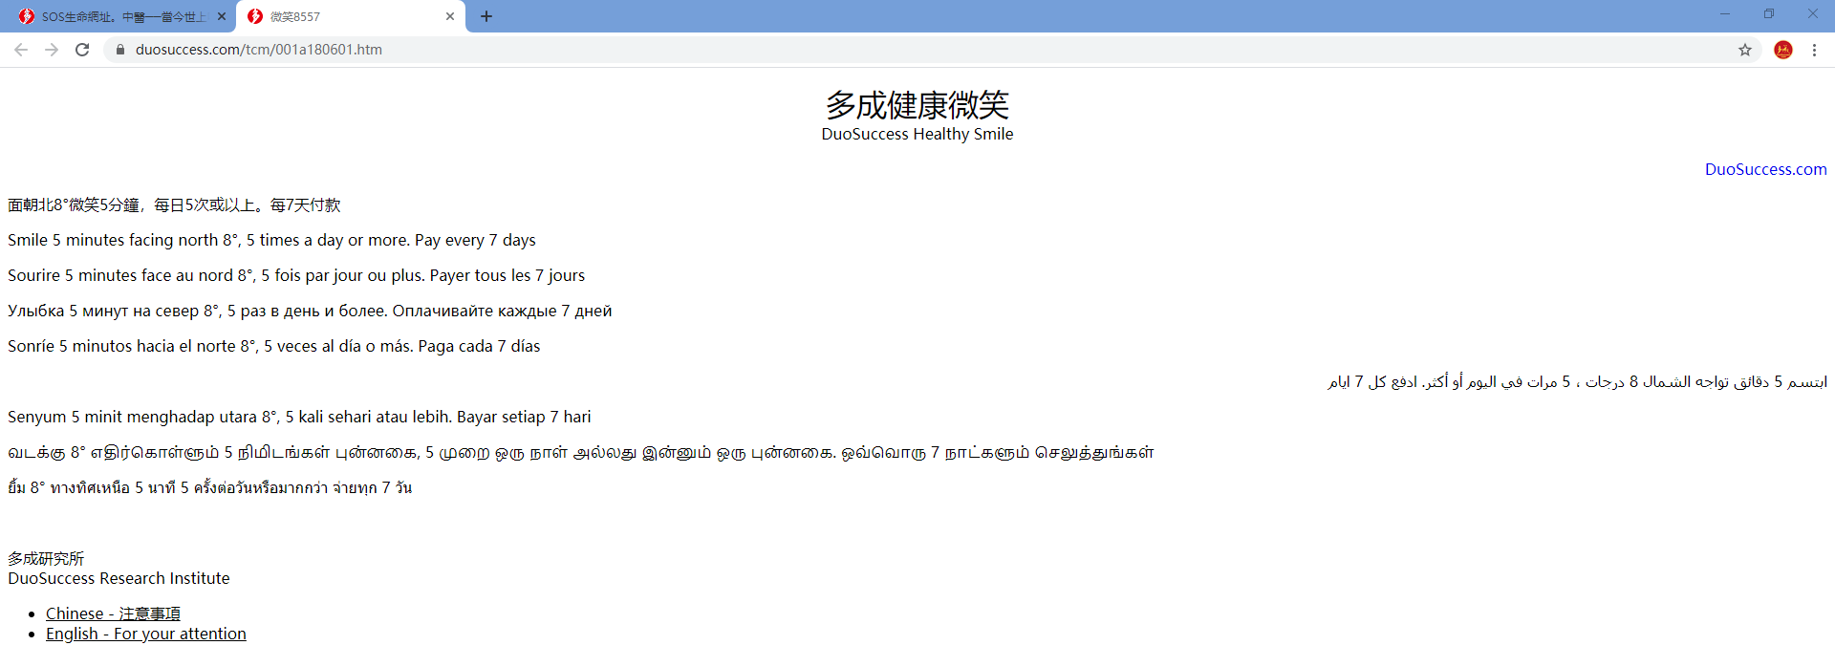
Click here to expand English description
DuoSuccess TCM Prevent and Cure Epidemic Diseases – DuoSuccess Healthy Smile
Notes:
The health smile webpage looks like this。
This does not need to be introduced too much, you can simply follow the instructions on the page.

Slide 20
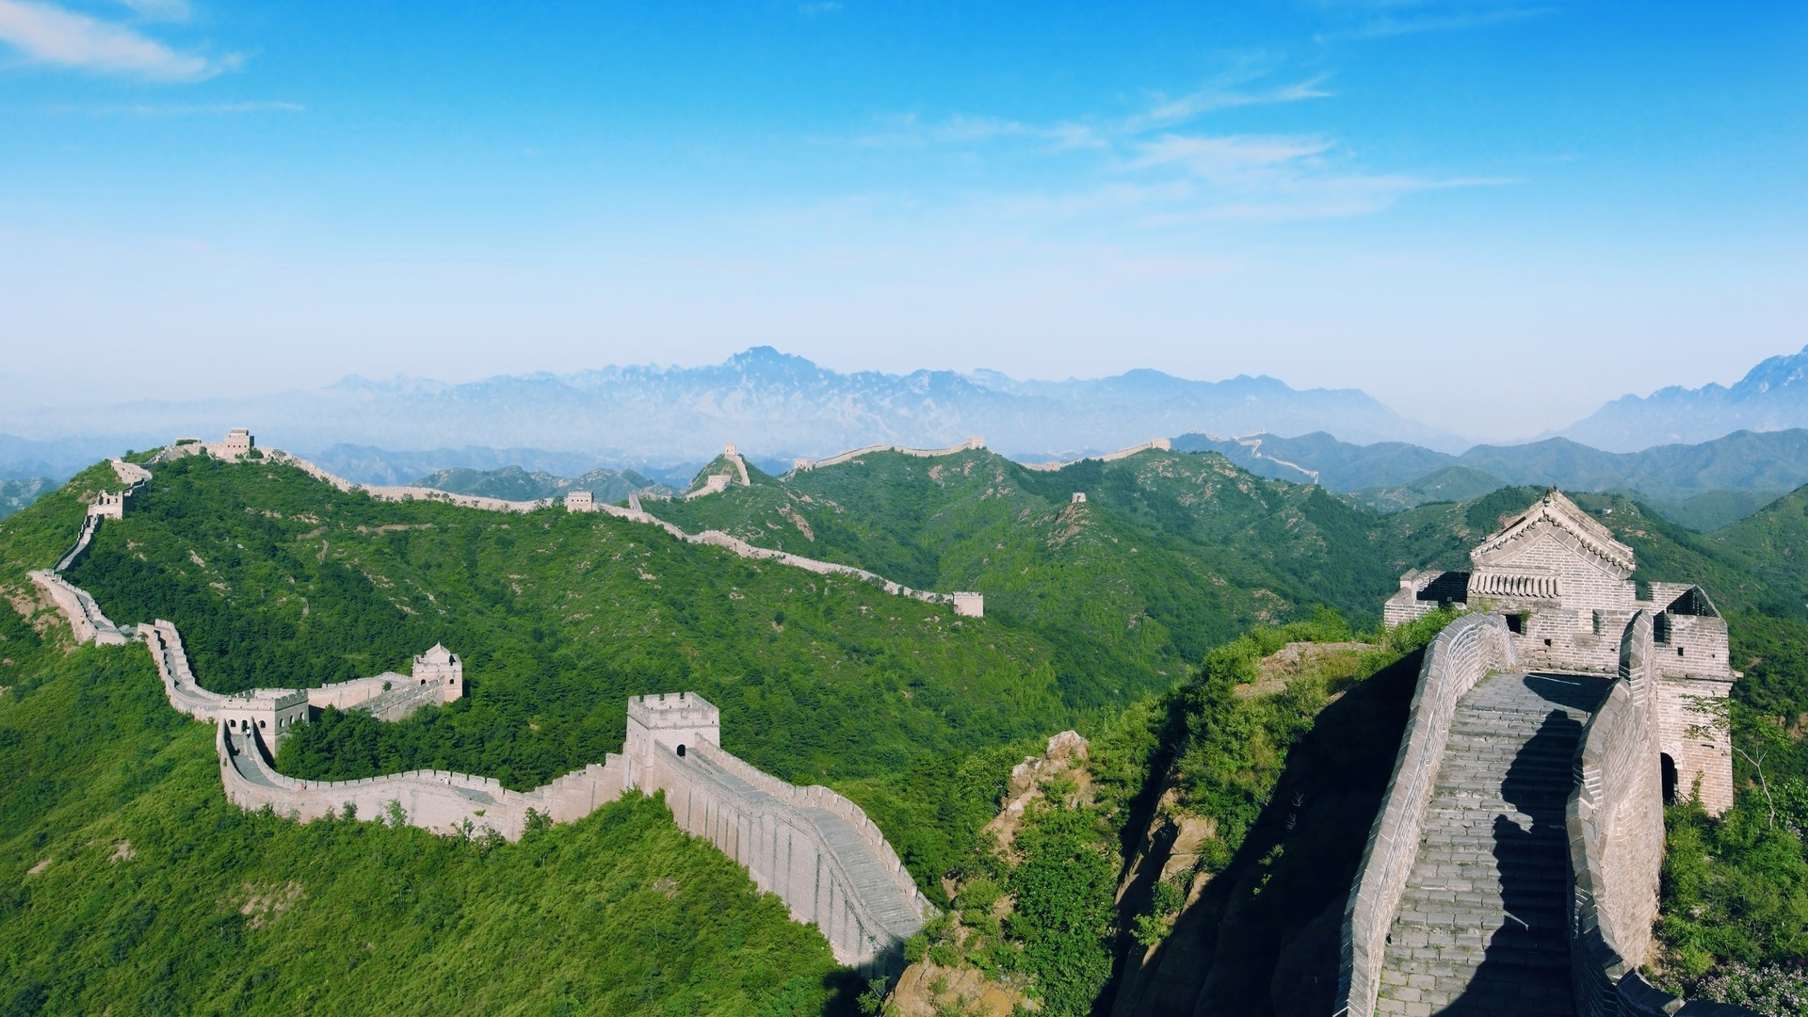
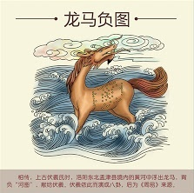
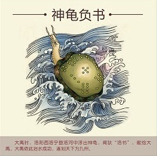
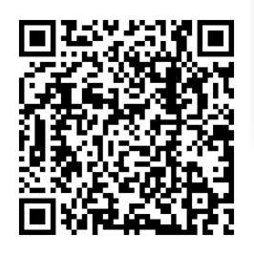
Remember: these prescriptions come from another civilization
Your scientists can not explain them
Your doctors are reluctant to verify them
You yourself might doubt them
But fortunately, you can experience their curative effect simply through practice
How to verify the efficacy of DuoSuccess TCM?
《書經•說命篇上》曰：“若藥弗瞑眩，厥疾弗瘳” – which means: “If no MingXuan reactions occur after taking medicine, the root of disease is not eliminated and the disease is not cured”
MingXuan Reactions do signal the potency and healing effect of our medicine, show the results of the treatment, curative effect of the therapy, normal sensation, healthy response and a symptom of improvement.
See the website(https://www.duosuccess.com/tcm/Q&A030122-English.htm) for detail
MingXuan Reactions - Proof of TCM efficacy
Notes:
All right. So far, all three prescriptions have been introduced.
These prescription forms may not be familiar to you
But remember: they come from another civilization.
Scientists cannot explain them, doctors are reluctant to verify them, and you yourself might doubt them
Fortunately, you can experience their curative effect simply through practice.
How to verify the efficacy?
《書經•說命篇上》曰：“若藥弗瞑眩，厥疾弗瘳” – which means: “If no MingXuan reactions occur after taking medicine, the root of disease is not eliminated and the disease is not cured”
You can See the website for detail

Slide 21

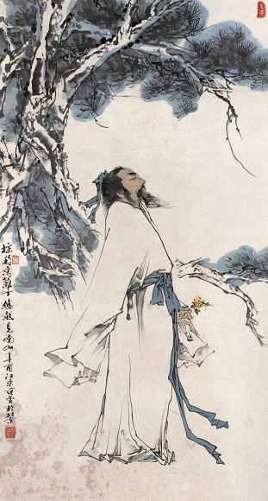
No need to worry about your treatment being delayed
Your doctors cannot provide any effective medicine
If they can, you don’t need us
No need to worry about health damage
these prescriptions are unlikely to cause any harm to you
No need to worry about losing money
DuoSuccess TCM provides free medical services to COVID-19 patients around the world
the 3 prescriptions recommended here are completely free
You really don't need to worry about anything while trying these prescriptions
Notes:
You really don't need to worry about anything while trying these prescriptions
First, you don’t need to worry about your treatment being delayed, because other doctors can’t come up with effective treatments;
Second, you don’t need to worry about your health being damaged, because the prescriptions recommended here seems unlikely to damage your health From the scientific point of view
Third, you don't need to worry about losing money. DuoSuccess TCM provides free medical services to COVID-19 patients around the world. The 3 prescriptions recommended here are completely free.

Slide 22
JUST TRY IT
you don’t need to believe me
wish you good health
Prevention, treatment, and sequelae treatment for COVID-19
DuoSuccess TCM Prevent and Cure Epidemic Diseases
Notes:
In a word: you don’t need to believe me, you just need to try it.

Slide 23
大醫精誠 孫思邈
張湛曰：“夫經方之難精，由來尚矣。”今病有內同而外異，亦有內異而外同，故五臟六腑之盈虛，血脈榮衛之通塞，固非耳目之所察，必先診候以審之。而寸口關尺，有浮沉弦緊之亂；俞穴流注，有高下淺深之差；肌膚筋骨，有厚薄剛柔之異。唯用心精微者，始可與言與茲矣。今以至精至微之事，求之於至粗至淺之思，其不殆哉！若盈而益之，虛而損之，通而徹之，塞而壅之，寒而冷之，熱而溫之，是重加其疾，而望其生，吾見其死矣。故醫方蔔筮，藝能之難精者也，既非神授，何以得其幽微？世有愚者，讀方三年，便謂天下無病可治；及治病三年，乃知天下無方可用。故學者必須博極醫源，精勤不倦，不得道聼塗説，而言醫道已了，深自誤哉！
凡大醫治病，必當安神定志，無欲無求，先發大慈惻隱之心，誓願普救含靈之苦。若有疾厄來求救者，不得問其貴贱貧富，長幼妍蚩，怨親善友，華夷愚智，普同一等，皆如至親之想，亦不得瞻前顧後，自慮吉凶，護惜身命。見彼苦惱，若己有之，深心悽愴，勿避嶮巇、晝夜、寒暑、饑渴、疲勞，一心赴救，無作功夫形跡之心。如此可為蒼生大醫，反此則是含靈巨賊。自古名賢治病，多用生命以救危急，雖曰贱畜貴人，至於愛命，人畜一也。損彼益己，物情同患，況於人乎！夫殺生求生，去生更遠。吾今此方所以不用生命為藥者，良由此也。其虻蟲、水蛭之屬，市有先死者，則市而用之，不在此例。只如雞卵一物，以其混沌未分，必有大段要急之處，不得已隱忍而用之。能不用者，斯為大哲，亦所不及也。其有患瘡痍、下痢，臭穢不可瞻視，人所惡見者，但發慚愧淒憐憂恤之意，不得起一念蒂芥之心，是吾之志也。
夫大醫之體，欲得澄神內視，望之儼然，寬裕汪汪，不皎不昧。省病診疾，至意深心，詳察形候，纖毫勿失，處判針藥，無得參差。雖曰病宜速救，要須臨事不惑，唯當審諦覃思，不得於性命之上，率爾自逞俊快，邀射名譽，甚不仁矣！又到病家，縱綺羅滿目，勿左右顧眄，絲竹湊耳，無得似有所娛，珍羞迭薦，食如無味，靈錄兼陳，看有若無。所以爾者，夫一人向隅，滿堂不樂，而況病人苦楚，不離斯須，而醫者安然歡娛，傲然自得，茲乃人神之所共恥，至人之所不為，斯蓋醫之本意也。
夫為醫之法，不得多語調笑，談謔喧嘩，道說是非，議論人物，炫耀聲名，訾毀諸醫，自矜己德，偶然治差一病，則昂頭戴面，而有自許之貌，謂天下無雙，此醫人之膏肓也。
所以醫人不得恃己所長，專心經略財物，但作救苦之心，於冥運道中，自感多福者耳。又不得以彼富貴，處以珍貴之藥，令彼難求，自炫功能，諒非忠恕之道。志存救濟，故亦曲碎論之，學者不可恥言之鄙俚也。

Slide 24
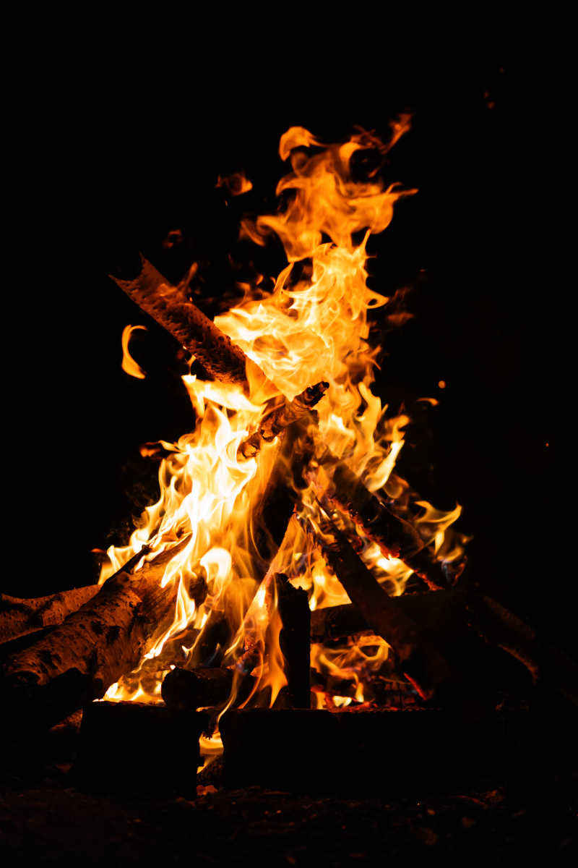
A story
Pastor MacDonald lives in a valley.
For 40 years, he took care of all the people in the diocese, baptized, organized funerals, weddings, and comforted the sick and widowed elderly.
One day, there was a sudden heavy rain and the flood soared. The old pastor climbed onto the roof of the church. Just as he was shaking, someone came in a row and shouted to him: "Come on, I will take you out of here."
The pastor looked at him and replied: "For 40 years, I have been doing things in accordance with God's will, baptizing, holding funerals, and comforting the sick and widowed elderly. I only take a one-week holiday a year, and during this one-week holiday, I went to an orphanage to help with cooking. I sincerely believe in God because I am a servant of God. Therefore, you can leave by boat and I will stay here and God will save me."
The man rowed away.
Two days later, the water level rose higher, and the old pastor hugged the top of the church tower tightly, and the water swirled around him. At this time, a helicopter flew in and the pilot shouted to him: "Father, hurry up, I will put down the hanger, you will fasten the sling on your body, and we will take you to safety."
The old pastor replied: "No, no." He once again told about his life's work and his belief in God. In this way, the helicopter also left.
A few hours later, the old pastor was washed away by the water and drowned.
He was quite angry at his last encounter. When he saw God, God was even more surprised, and God shouted: "Father MacDonald! What a surprise!"
The old pastor stared at God and said: "Surprise? For 40 years, I have done things according to your will, and I have done things better than others, but when I needed you the most, you drowned me!"
God looked back at him and said in a puzzled way:
"You are drowned? I don't believe it, I'm sure I sent you a boat and a helicopter."
Notes:
Finally, please allow me to share a story with you

